Slide 1
Digital Portfolio
STUDENT NAME: A.Dharshini
REGESTER NO AND NMID: autunm1455ds242725
DEPARTMENT: BSC(CS WITH DS)
COLLAGE: TAGORE COLLAGE OF ARTS AND SCIENCE MADRAS UNIVERSITY

Slide 2
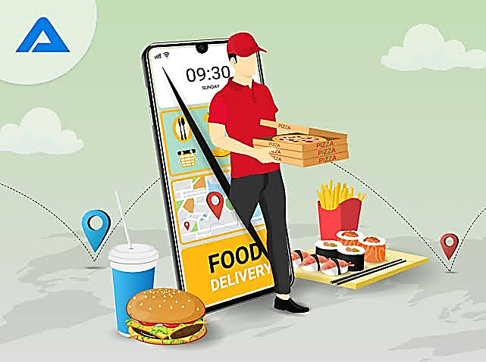
TITLE SLIDE
PROJECT TITLE: Online Food Ordering System
Tagline:” FAST ORDERS,FRESH TASTE”
(Also add fill Name, Address, street, city, Pincode)

Slide 3

AGENDA
Problem Statement
Project overview
End Useres
Tools & Technologies
Design & Layout
Feature & Functionality
Conclusion
Git Hub Link

Slide 4

PROBLEM STATEMENT
❌ Traditional food ordering has many issues:
Long queues and waiting time in restaurants
Miscommunication in orders placed by phone
Limited food choice visible to customer
There is a need for a faster, reliable and digital food ordering solution .

Slide 5
PROJECT OVERVIEW
✨The online food ordering system is a Web-based platform that allows customer to browse menus ,place orders, and make payments online.
Provides a smooth experience for customer and restaurants
Ensures real-time order updates
Make food ordering more convenient and efficient

Slide 6
END USERS
🎯Target audience includes:
CUSTOMERS → Can browse menus, order food, and pay online
RESTARUNTS → Manage menus, track orders, and serve faster
DELIVERY AGENTS → Receive customer address and deliver food efficiently

Slide 7
Tools & technologies
⚙️technology stack used:
Fronted: HTML, CSS, JavaScript
Backend: Python Flack / PHP / Node.js
Database: MYSQL / SQLite(for storing orders, users, menus)
Hosting: GitHub pages / Web server
Version Control: GitHub

Slide 8

DESIGN & LAYOUT
💻simple and user-friendly design:
Home page→ Restaurant introduction & offers
Menu page → List of food items with prices & images
Cart page → Selected items with total bill
Order Tracking Page → Real-time status of delivery
Admin page → Restaurant can add/update menu items

Slide 9
FEATURES & FUNCTIONALITY
✨ The System includes:
Users login & registration
Online menu browsing
Add to cart & place order option
Online Payment integration(optional)
Real-time order tracking
Admin Dashboard for restaurants

Slide 10

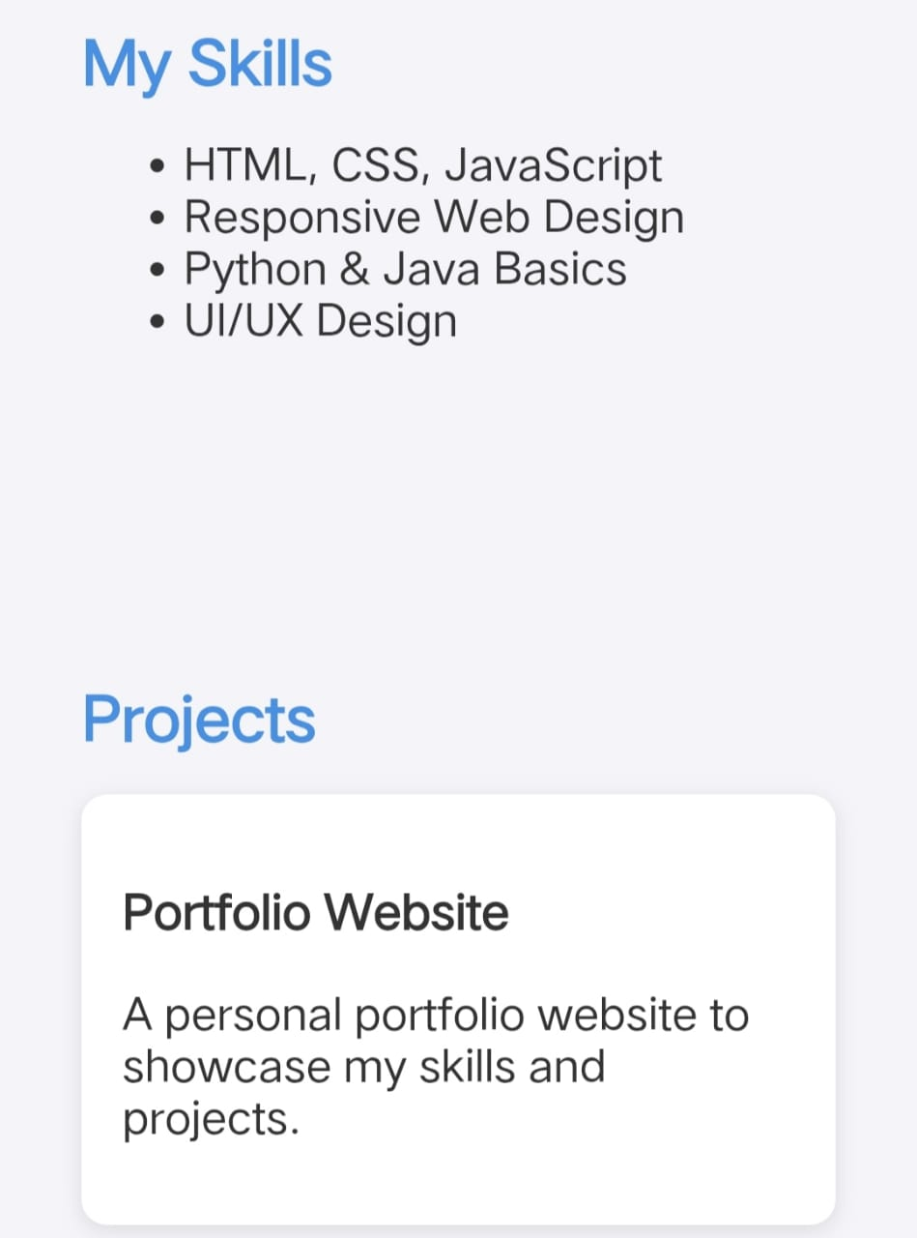
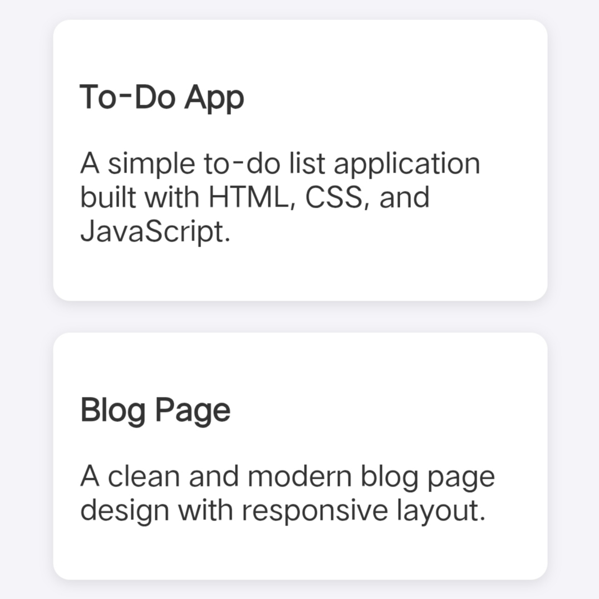
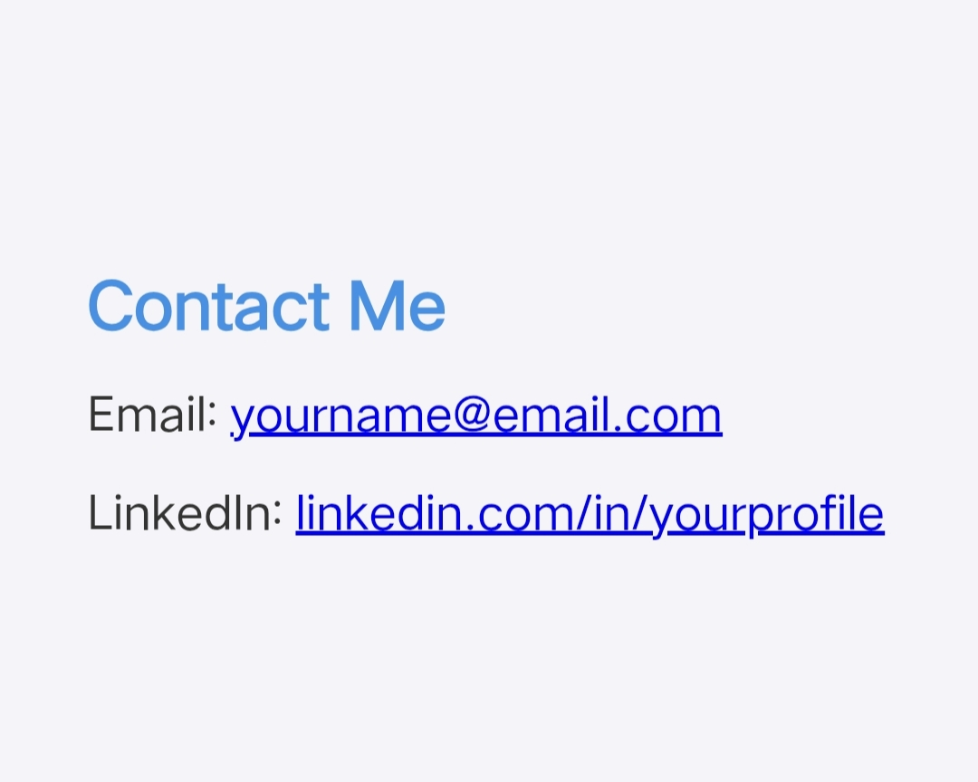
RESULTS AND SCREEN SHOETS

Slide 11
CONCLUSION
🚀 The Online Food Ordering System Provides:
A modern, time-saving solution for both customer & restaurants
Improve customer satisfaction with easy ordering and tracking
A stop towards digital transformation in the food industry

